Slide 1

Section 11.1 Sequences
Lecture 1
Idea and Notation

Slide 2
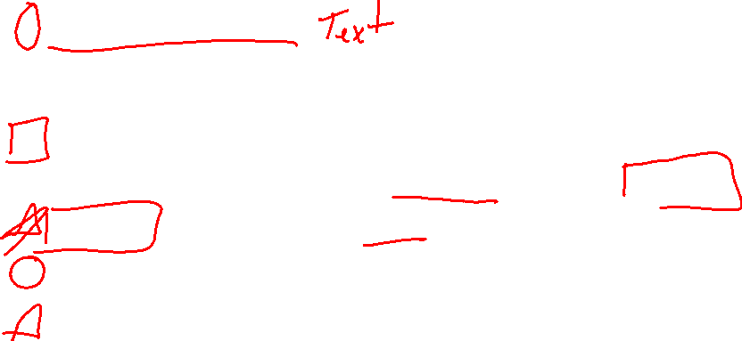
Section 11.1 Homework Submission to Canvas
Preview of section
Skim section, write short paragraph summary, list all important definitions / theorems / formulas.
Notes on video lectures
Include all details, worked examples, your own thoughts
Worked examples from text
Solutions to exercises
Final reflection of section
List of key takeaways to remember

Slide 3
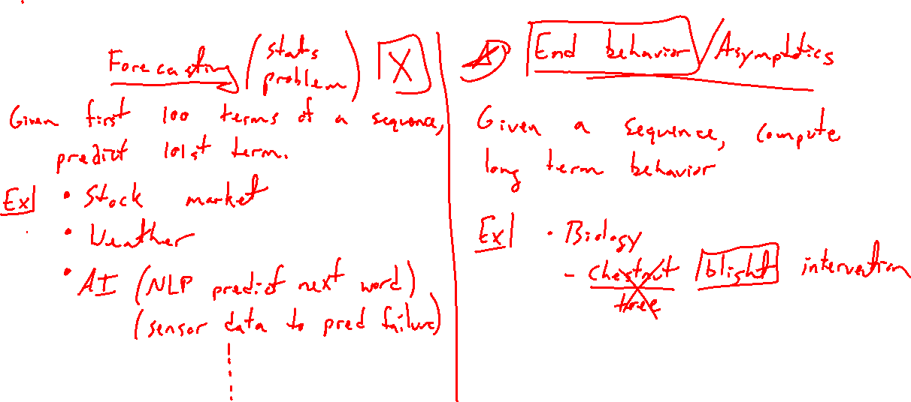
Motivation of Sequences
Notes:
2 problems:
- Forecasting: given n terms, predict next. Stock market, weather, populations, etc.
- End behavior / asymptotics: What will happen in the end? UWL chestnut tree story

Slide 4
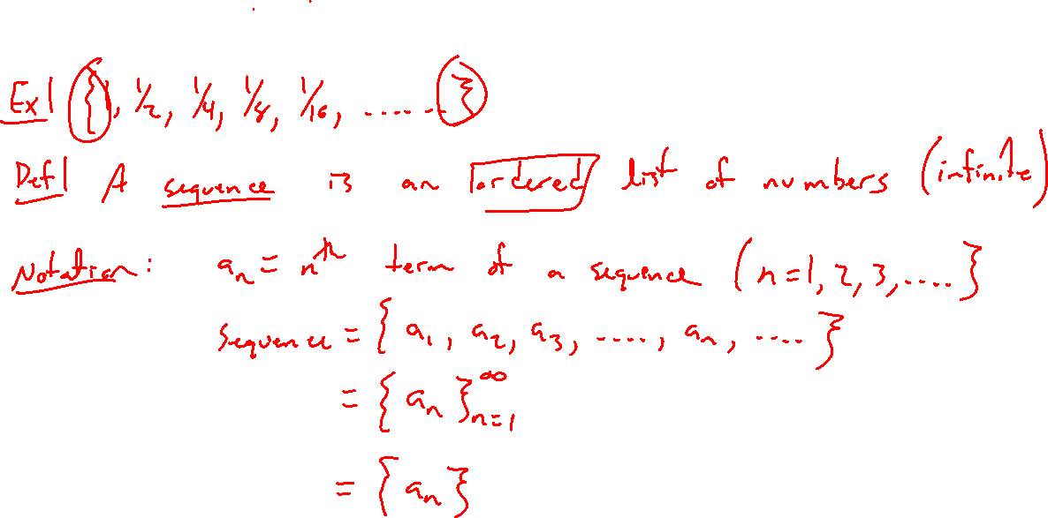
Sequence Definition and Notation
Notes:
Basic example: 1, ½, ¼, 1/8, …
Careful definition:
Notation examples: a_n is called the nth term

Slide 5
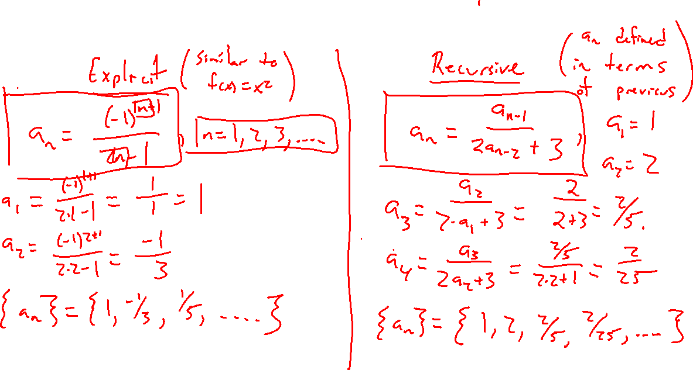
Sequences Formulas
Notes:
Explicit vs Recursive

Slide 6
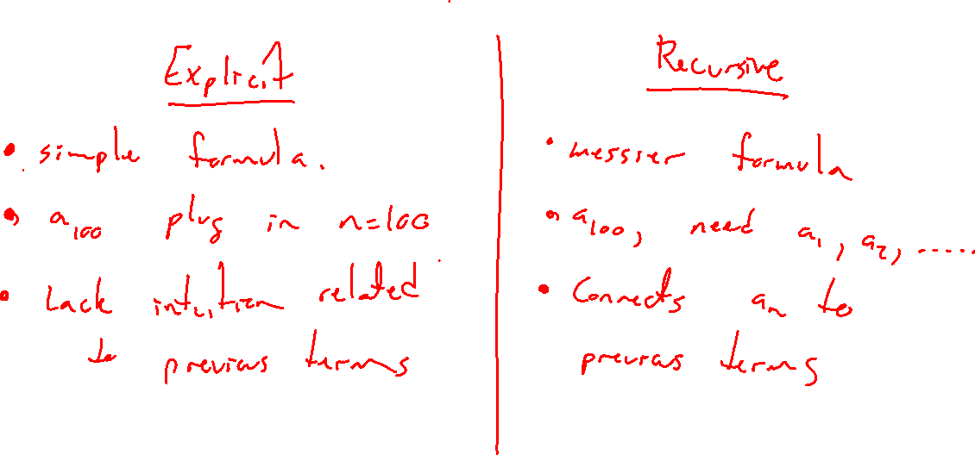
Sequence Formulas
Notes:
Examples
Explicit vs recursive
Sometimes can do both, pros and cons of each.

Slide 7
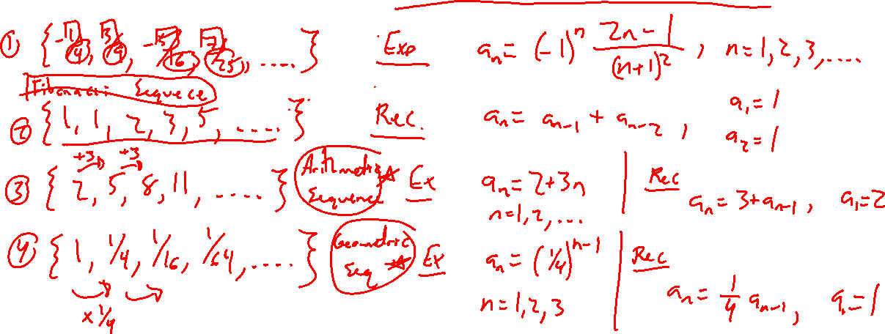
Sequence Examples: Give Formulas for Each
Notes:
Examples
Explicit vs recursive
Sometimes can do both, pros and cons of each.

Slide 8
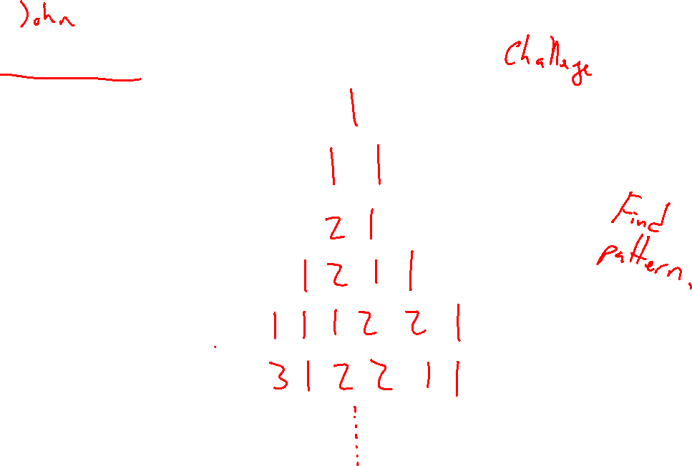
Conway's Famous Sequence
Notes:
List and let them guess. Reveal in next lecture.

